Slide 1
Visual Basic
Guide

Slide 2
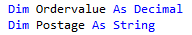
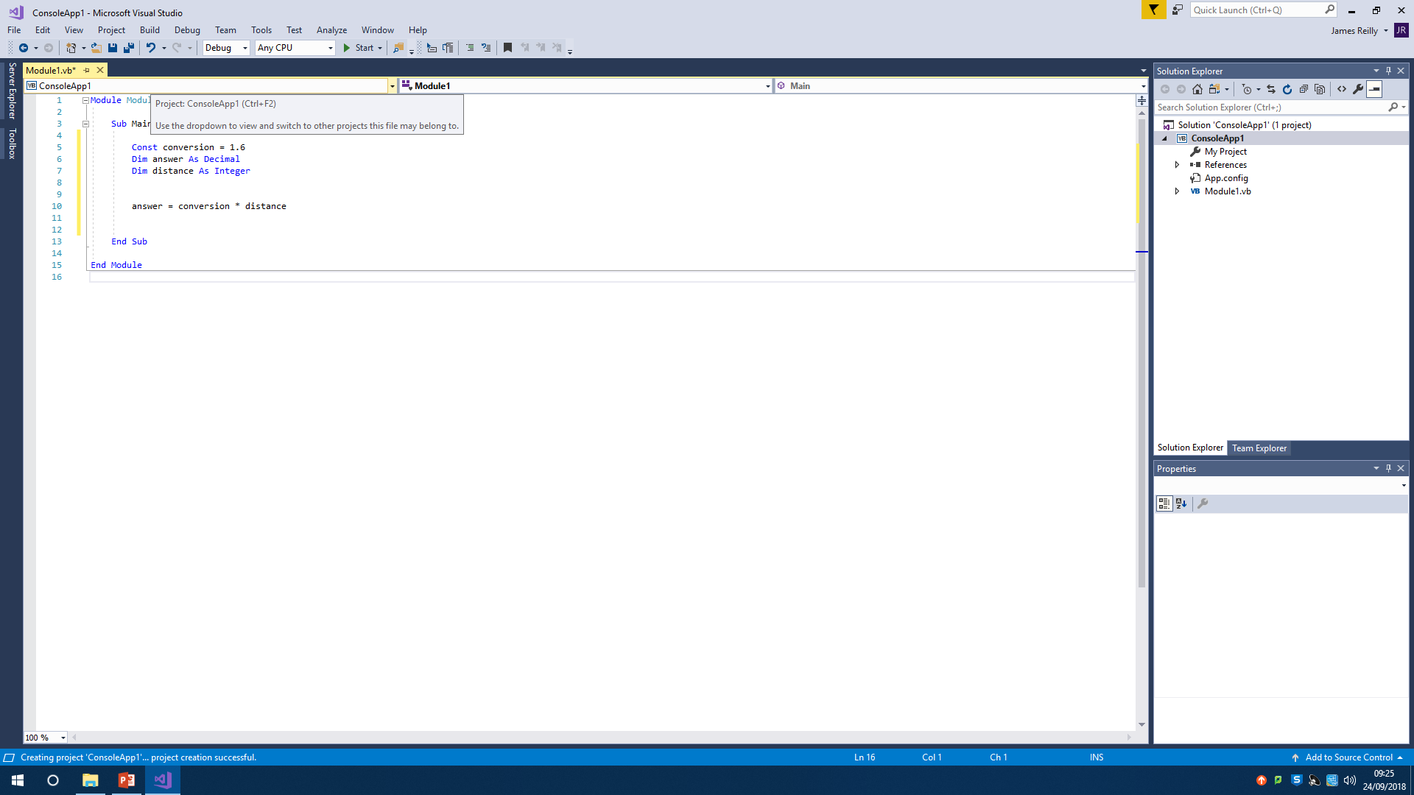
Variables and Constants
‘Dim’ is used to declare something as a variable. This means it can change as the program runs, and is not a fixed value. In this case, the ordervalue can change as it is inputted by the user, and postage can changed based on the value, so both are variables.
The data type following the word and, (in this case, ‘decimal’ and ‘string’ tell you what the named thing is. So in this case, the ‘ordervalue’ is a decimal number, and the ‘postage’ is a string of characters (letters and numbers)
‘Const’ is used to define something as a constant. In this case, it is used to convert distances. Since the conversion rate remains the same, it is declared as a constant.

Slide 3
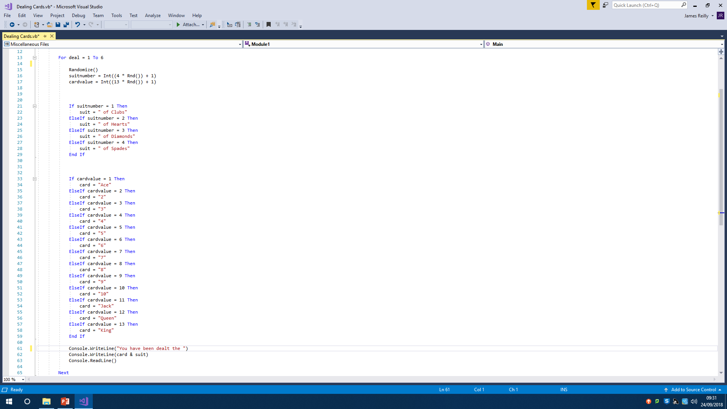
Loops
This ‘for next’ loop repeats the code written in between the ‘for’ and the ‘next’. The ‘1 To 6’ indicates how many times the code will be repeated before the computer continues past and runs the rest of the code.

Slide 4
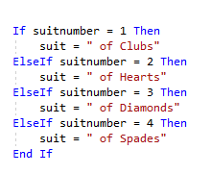
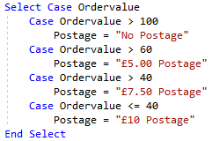
If, Else If, Else, Select Case
‘If’ commands are used to make a computer perform certain actions based on a condition. It starts with an ‘If’, followed by a condition, followed by ‘Then’ and then the action. The ‘ElseIf’ essentially says if the previous is not true, then try the following condition. ‘Else’ is the final part, used if none of the other conditions are not fulfilled. The command is ended with the ‘End If’ line.
‘Case’ commands are used in the same situations as ‘if’ commands and are interchangeable. It starts with ‘Select Case’ and then the piece of data you are using. Then the word ‘case’ and then a condition. This is followed by the instruction if the condition is met. At the end, it is finished with ‘end select’
‘Select case’ commands are quicker than ‘if’ commands, as the computer only has to find the code that applies. For example, in this scenario, if the ordervalue is 68, it will check against the >100, then against the >60, then it will follow the instructions. Whereas the ‘if’ command would keep checking against everything before it follows the instructions

Slide 5
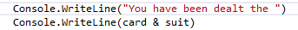

Console.Read/Writeline
The ‘Console.Writeline’ command is used to get the program to say certain things. This can be to show the value of pieces of data, such as the card and suit, or it can be used to write a piece of text, using the “”.
The ‘Console.Readline’ command tells the computer to read the line above. In this case, the ordervalue is defined by the line above, so whatever the value of the item is. The ‘Console.Readline’ command is very useful for getting input from the user of the program. It is also used at the end of the program’s code in order to keep it open, this means that at the end of the program, you can scroll back and double check everything worked as expected.

Slide 6
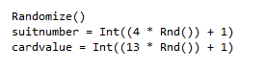
Randomise
This command is used to generate a partially random number. It is partially random because it has to be in between two values. ‘Randomize’ starts the command. This is followed by the data you wish to be random. Then ‘=‘ and then ‘int’, which ensures that the random number generated is an integer. Then the ‘4’ or the ‘13’ defines the largest number you would like to appear. The ‘* Rnd’ means from 0 to the value. In this case it would be 0,1,2,3,4. the ‘+1’ at the end inside the brackets is to add 1 to the possible numbers, so that instead of 0 to 4, it’s 1 to 4. the 0 to 4 could be used, however later on the value 0 must be used rather than 1.

Slide 7
Arrays

